Slide 1

Conditional Expressions and Control Statements
Boolean Logic, IF and SWITCH Statements

Slide 2
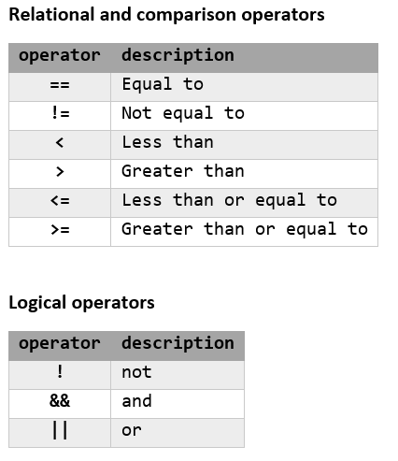
Conditional Expressions
Sequence of identifiers
Separated by compatible operators
Evaluates to true or false
Examples:
    a >= b
    a == 2*3
    b != c % 2

Slide 3
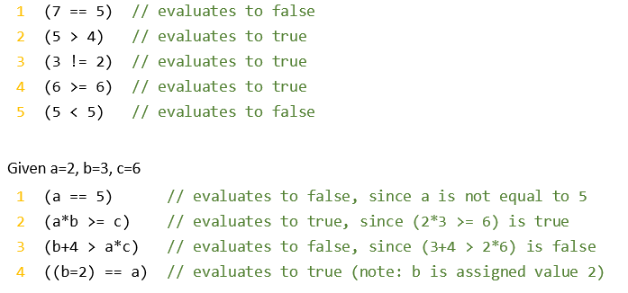
Relational & Comparison Expressions
Relational operators (==, !=) test for equality
  Be careful not to use the assignment operator (=)
Comparison operators (<, >, <=, >=) test value ranges
Don’t ever do this!

Slide 4
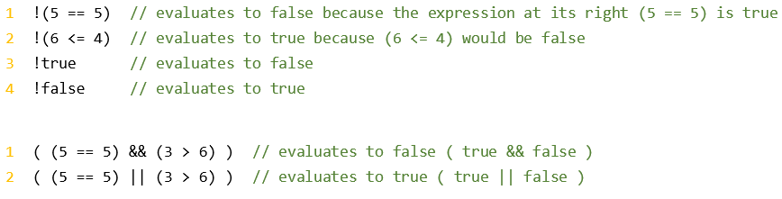
Logical
Expressions
Boolean expression is any expression that evaluates to true or false
Logic operators (!, &&, ||) test Boolean values of multiple expressions
  NOT (!) returns the opposite of the right Boolean expression
    Note: the NOT operator takes only one operand to its right
  AND (&&) returns true if both the left and right Boolean expressions are true
  OR (||) returns true if either the left or right Boolean expression is true
C++ bool datatype has literal values false=0 and true=1
Any expression that results in 0 is evaluated as false
Any expression that results in a non-0 is evaluated as true

Slide 5
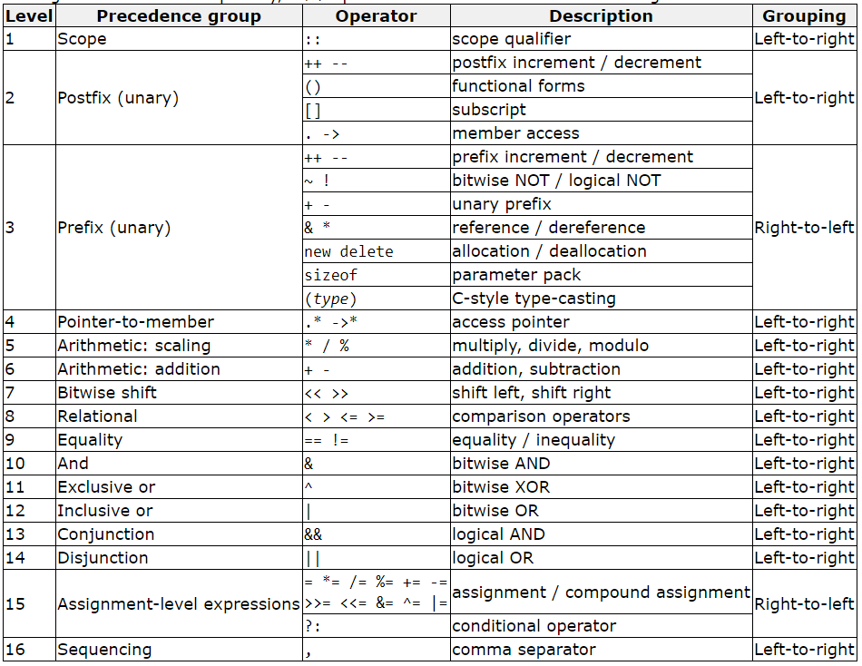
Operators:
Order of Precedence

Slide 6

Conditional Ternary Operator
The ternary operator (?) allows us to perform an inline IF-THEN-ELSE expression
  Syntax:
  condition ? result1 : result2
  The expression returns result1 if the condition is true, and result2 if the condition is false

Slide 7
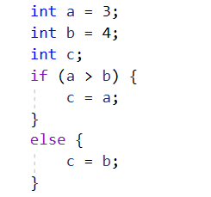
IF Statement
IF keyword executes a statement or block if the condition is true
Syntax:
if ( condition ) statement;
Enclose multiple statements in braces ({ }) to define a block of statements to execute
Syntax:
if ( condition ) {
statement;
…
}
The else keyword defines a statement or block of statements to execute if the condition is false
    Syntax:
    if ( condition ) {
    statement;
    …
    }
    else {
    statement;
    …
    }
Recommended syntax unless single IF with single statement

Slide 8
IF Statement ELSE IF Blocks
The else if keyword defines a statement or block of statements to execute if additional conditions are true
Syntax:
if ( condition ) {
statement;
…
}
else if ( condition ) {
statement;
…
}
    else if ( condition ) {
    statement;
    …
    }
else {
statement;
…
}
There can be more than one ELSE IF block
Each ELSE IF requires a conditional expression
There can be only one ELSE block and it cannot have a condition

Slide 9
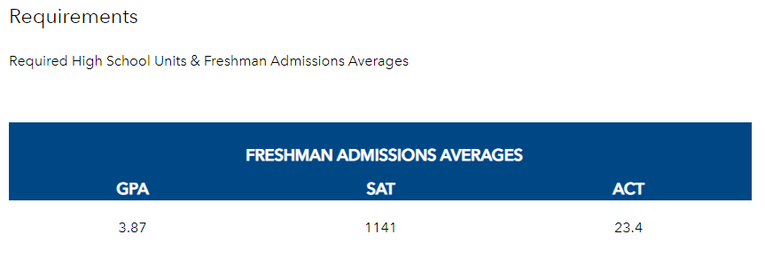
IF Statement Example:
Undergraduate
Admissions
Requirements
Undergraduate Admission Requirements
  Must have a GPA of 3.87 or higher
  And must have either
    SAT score of 1141 or higher
    ACT score of 23.4 or higher

Slide 10

IF Statement Example:
Undergraduate
Admissions
Requirements
Single IF statement
Using combination of comparison and logical conditional operators
Pros / cons:
  Less code
  Difficult to read or change if requirements need to be added
Note: single IF with single statement, so curly braces not required

Slide 11
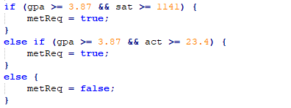
IF Statement Example:
Undergraduate
Admissions
Requirements
IF-ELSE IF-ELSE statement
Break into smaller conditions
Pros / cons:
  Easier to read and change
  Duplicated evaluation of GPA
ELSE block not required if metReq variable set to false before the IF statement

Slide 12
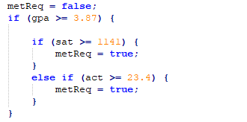
IF Statement Example:
Undergraduate
Admissions
Requirements
Nested IF statements
Break into single comparison conditions
Pros / cons:
  Easier to read and change
Note: multiple levels of tabbing to show ownership and scope in each block
Why should you use an ELSE IF for the ACT comparison instead of a separate IF statement?

Slide 13

IF Statement: Bool Variable in Conditional
An IF statement can evaluate a bool variable directly
A bool variable has a Boolean value
Does not require a comparison operator

Slide 14
Set Bool with Boolean Expression
A bool variable type can be set using any Boolean expression
Do not need IF statement structure
Pros / cons:
  Confusion between assignment operator and comparison operators
  Difficult to read and change
Probably better to wrap whole Boolean expression in parentheses:
bool var = ( a >= b && ( c >= d || e >= f));

Slide 15
SWITCH Statement
Check for value of expression against several possible constant expressions
Syntax:
  switch (expression) {
  case constant1:
  statement;
  …
  break;
  case constant2:
  statement;
  …
  break;
  .
  .
  .
  default:
  statement;
  …
  }
Variable or expression that returns a value
Constant value
Exit switch statement
If value of expression does not match any constant value

Slide 16
SWITCH Statement:
Rules
Only short, int, long, char, or enum data types can be used
Constant values must be of same data type as expression
Cannot use range values (i.e. < or > )
Should have at least 3 optional values
  use IF statement when less than 3
Do not declare variables inside SWITCH or CASE blocks
  Some may work, and others will cause compiler errors
Leaving off a BREAK keyword causes CASE blocks to fall-through as if an OR is used:
  switch (expression) {
  case constant1:
  case constant2:
  statement;
  …
  break;
  }
The BREAK keyword is not required for the last block, CASE or DEFAULT
DEFAULT block is not required, but is recommended
// expression == constant1 || constant2

Slide 17
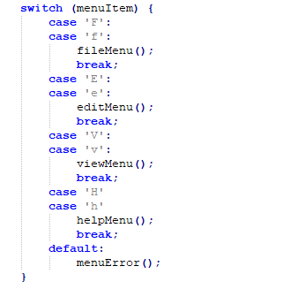
SWITCH Statement:
Uses
Control program flow to one of several sub-procedures, such as a menu
Translate or map values to other values, such as numbers to colors, or vice versa
Map individual keystrokes to action values (how might we use this?)
Example:

